Slide 1

LOG ANALYZE

Slide 2
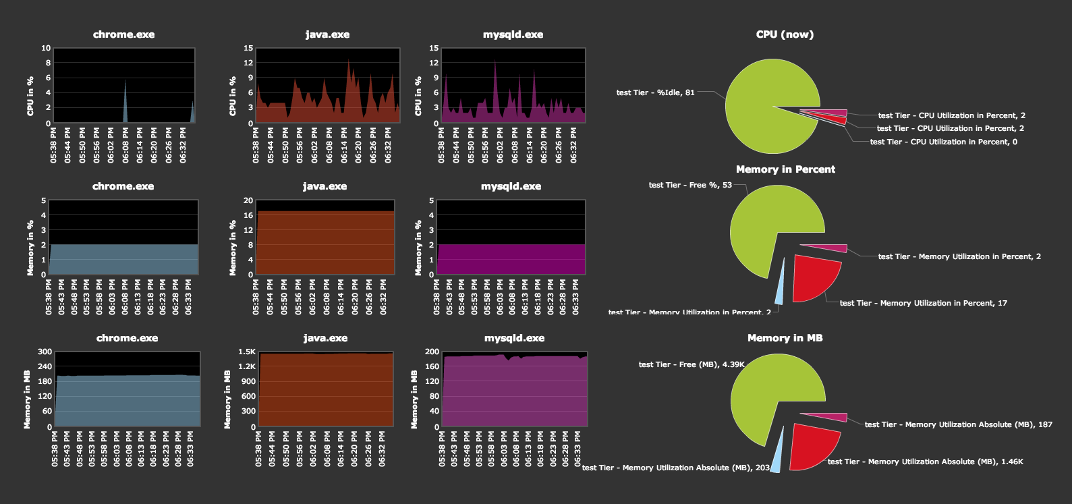
Benefits
Production monitoring and debugging
Resource usage

Slide 3
Benefits
Performance analysis

Slide 4
Benefits
Tracking client requests
Identifying key trends

Slide 5
Workflow

Slide 6
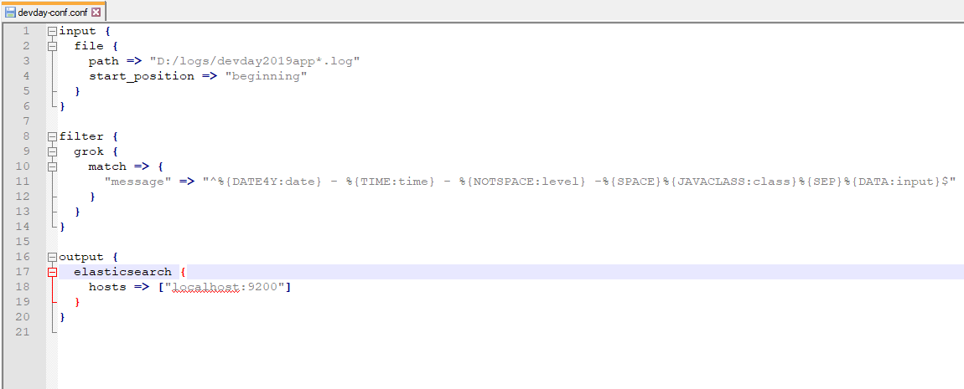
Logstash
Parse log line into readable format

Slide 7
Elasticsearch
Store logs
Act as a datasource for Kibana

Slide 8
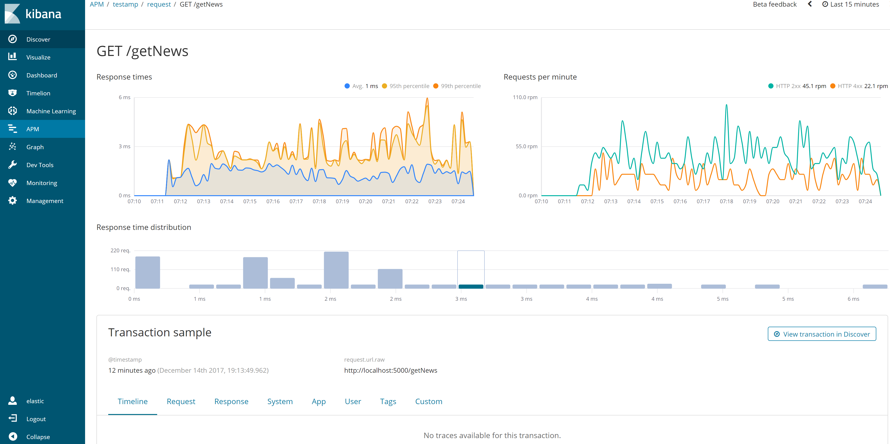
Kibana
Display data using chart

Slide 9
Getting started
1. Know your log structure
2. Parse log by Logstash
3. Visualize by Kibana

